Slide 1

Epitopes Affinity maturation Recognition of antigen by B cells Neutralizing Antibody
Dr. (Ms.) Sonali Correa

Slide 2
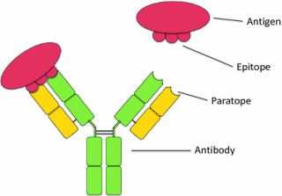
Epitopes
Epitopes, also known as antigenic determinants, are the immunologically active discrete sites on the antigen molecule that physically bind to antibodies, B-cell receptors, or T-cell receptors.
Is a specific piece of the antigen to which an antibody binds
The part of an antibody that binds to the epitope is called a paratope
Are usually non-self proteins, however, sequences derived from the host that can be recognized (as in the case of autoimmune diseases) are also epitopes.
This paratope is only capable of binding with one unique epitope.
B cells can recognize an epitope alone but T cells can recognize an epitope only when it is associated with an MHC molecule on the surface of a self-cell (either an antigen-presenting cell or an altered self-cell).

Slide 3
The epitopes of protein antigens are divided into two categories, conformational epitopes and linear epitopes, based on their structure and interaction with the paratope.
Conformational epitope is a discontinuous sequence of residues amino acids sub-units composing an antigen that come in direct contact with a receptor of the immune system. Can be recognized solely by B cells
Linear or a sequential epitope is an epitope that is recognized by antibodies by its linear sequence of amino acids, or primary structure. Can be recognized by both T and B cells
In contrast, most antibodies recognize a conformational epitope that has a specific three-dimensional shape and its protein structure.
Conformational and linear epitopes interact with the paratope based on the 3-D conformation adopted by the epitope, which is determined by the surface features of the involved epitope residues and the shape or tertiary structure of other segments of the antigen.

Slide 4
Properties | Linear epitopes | Conformational epitopes
Location | Most polysaccharides, fibrilar proteins, and single-stranded nucleic acids. | Most globular proteins and native nucleic acids
Composition | Adjacent amino acid residues in the covalent sequence | Amino acid residues brought into proximity to one another by folding
Antigen-antibody reactions | Dependent on linear structure of 6 amino acids | Dependent on the 3-dimensional structure
Availability for antibody interaction | Become available upon denaturation of proteins | Usually associated with native proteins

Slide 5
Functions of Epitopes
B cells recognizes an enormous variety of epitopes (also referred to as B-cell epitopes): those displayed on the exposed regions of bacteria or viral particles, as well as those displayed on soluble proteins, glycoproteins, polysaccharides, or lipopolysaccharides that have been released from invading pathogens.
When B cells are exposed to T-dependent antigens, they get activated and undergo class switching, affinity maturation, and differentiate into plasma cells.
Plasma cells produce large amounts of antibody specific for the epitope recognized by their immunoglobulin receptor.
T cells recognizes protein epitopes (also referred to as T-cell epitopes) displayed together with MHC molecules on self-cells, including altered self-cells such as virus-infected self-cells and cancerous cells.
As T cells recognize only the processed peptides, those epitopes may be located on those regions (e.g., internal proteins) which are inaccessible to B-cells.
Each branch of the immune system uniquely suited to recognize antigen in a different environment.

Slide 6
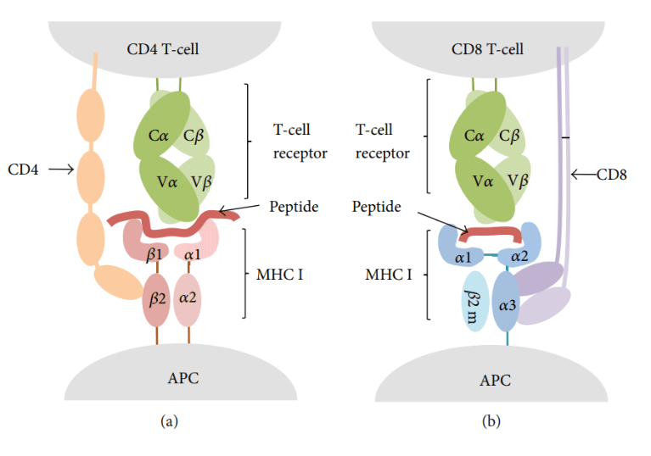
T-cell epitopes
T cell epitopes are presented on the surface of an APC
T-cell epitopes are presented by class I (MHC I) and II (MHC II) MHC molecules that are recognized by two distinct subsets of T-cells, CD8, and CD4 T-cells, respectively.
There are CD8 and CD4 T-cell epitopes.
T-cells become cytotoxic T lymphocytes (CTL) following T CD8 epitope recognition. Meanwhile, primed CD4 T-cells become helper (Th) or regulatory (Treg) T-cells.
T cell epitopes presented by MHC class I molecules are typically peptides between 8 and 11 amino acids in length, whereas MHC class II molecules present longer peptides, 13–17 amino acids in length, and non-classical MHC molecules also present non-peptidic epitopes such as glycolipids.

Slide 7
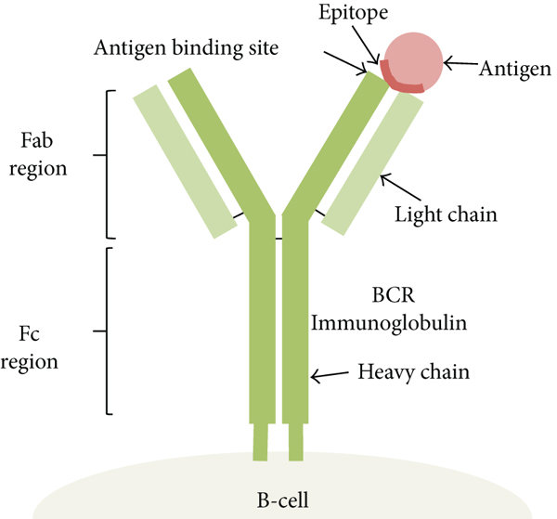
B-cell epitopes
The part of the antigen that immunoglobulin or antibodies bind to is called a B-cell epitope.
B cell epitopes can be divided into two groups: conformational or linear.
B cell epitopes are mainly conformational.
There are additional epitope types when the quaternary structure is considered.
Epitopes that are masked when protein subunits aggregate are called cryptotopes.
Neotopes are epitopes that are only recognized while in a specific quaternary structure and the residues of the epitope can span multiple protein subunits and are not recognized once the subunits dissociate

Slide 8
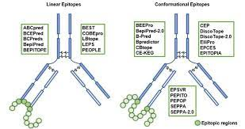
B-cell epitopes are categorized into linear and conformational epitopes.
A linear b-cell epitope is a contiguous amino acid segment in an antigen.
A conformational b-cell epitope is located in close proximity in the protein 3-dimensional structure but discontinuous in the protein sequence.
The features of B cell epitope are hydrophilicity, surface accessibility, beta turns, exposed surface, polarity and antigenic properties of amino acids.
These properties of polypeptides chains have been correlated with the location of the continuous and discontinuous conformational epitopes

Slide 9
Most B-cell epitopes are discontinuous in sequence, meaning that they are composed of residues that might be far apart in sequence and are brought together in spatial proximity by the protein folding
Data describing such conformational epitopes are mainly obtained from experimentally resolved 3D structures of antibodies co-crystallized with their target antigen, which allows a very precise identification of the epitope residues.
Methods include protein crystallography, ELISA and peptide-chip, but in general they are expensive, time consuming, low-throughput, or have low accuracy. Computational methods include BepiPred, DiscoTope, CBtope, and ABCpred
B-cell epitope prediction tools can broadly be categorized in two groups: sequence- and structure-based methods
Notes:
B-cells can neutralize pathogenic molecules by targeting them with extreme specificity using receptors secreted or expressed on their surface (antibodies). This is achieved via molecular interactions between the paratope (i.e., the antibody residues involved in the binding) and the interacting region (epitope) of its target molecule (antigen)

Slide 10
Epitope mapping
Epitope mapping is the process of experimentally identifying the binding site, or "epitope", of an antibody on its target antigen (usually, on a protein).
Identification and characterization of antibody binding sites aid in the discovery and development of new therapeutics, vaccines, and diagnostics
epitope characterization can also help elucidate the mechanism of binding for an antibody and can strengthen intellectual property (patent) protection
Experimental epitope mapping data can be incorporated into robust algorithms to facilitate in silico prediction of B-cell epitopes based on sequence and/or structural data

Slide 11
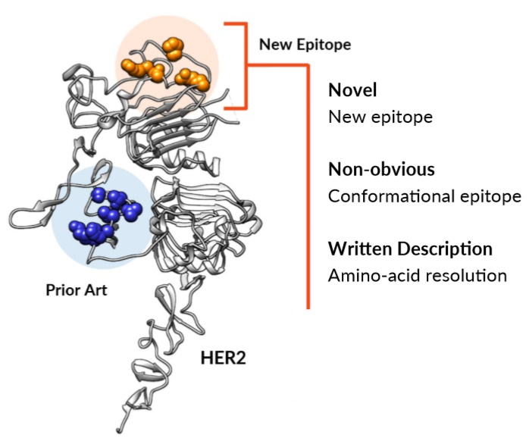
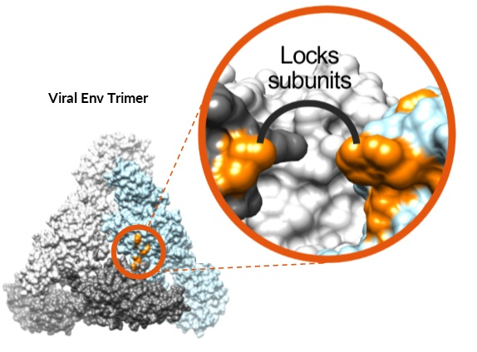
Epitope data benefits
Epitopes Differentiate Mechanism of Action
Epitope Maps Strengthen Intellectual Property

Slide 12
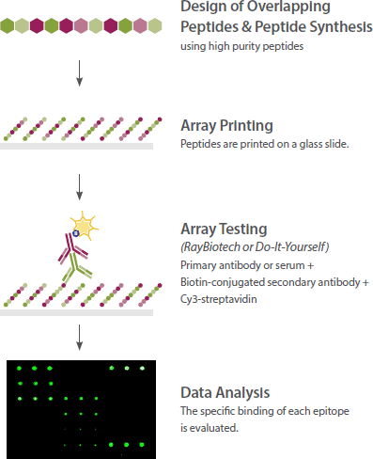
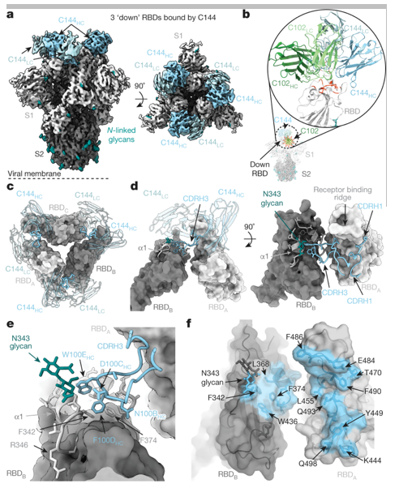
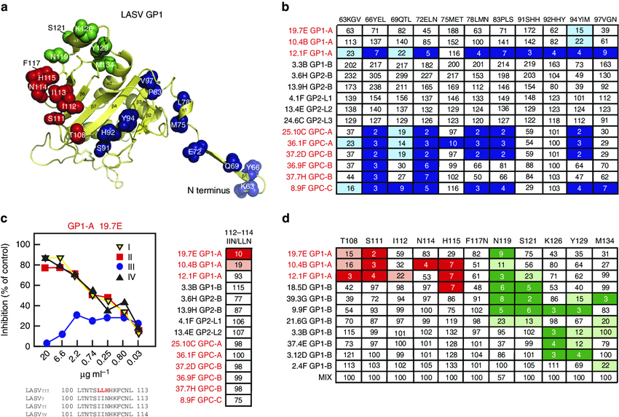
Methods
X-ray co-crystallography and cryogenic electron microscopy (cryo-EM)
X-ray co-crystallography has historically been regarded as the gold-standard approach for epitope mapping because it allows direct visualization of the interaction between the antigen and antibody. Cryo-EM can similarly provide high-resolution maps of antibody-antigen interactions
Array-based oligo-peptide scanning
Also known as overlapping peptide scan or pepscan analysis, this technique uses a library of oligo-peptide sequences from overlapping and non-overlapping segments of a target protein, and tests for their ability to bind the antibody of interest.
Site-directed mutagenesis mapping
The molecular biological technique of site-directed mutagenesis (SDM) can be used to enable epitope mapping. In SDM, systematic mutations of amino acids are introduced into the sequence of the target protein.
Mapping of putative epitopes recognized by LASV mAbs by site-directed mutagenesis. Wild-type recombinant LASV GPC was engineered with altered amino-acid sequences to map putative B-cell epitopes on LASV glycoproteins.
Cryo-EM structure of the C144-S complex illustrates a distinct VH3-53 NAb binding mode. (Barnes C O, et al. 2020)

Slide 13
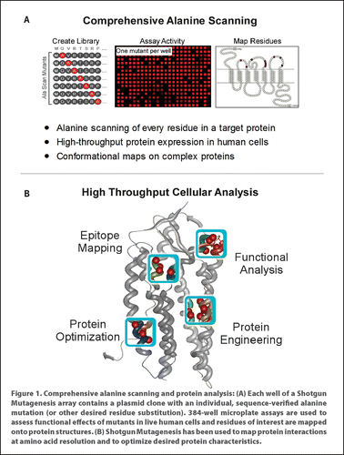
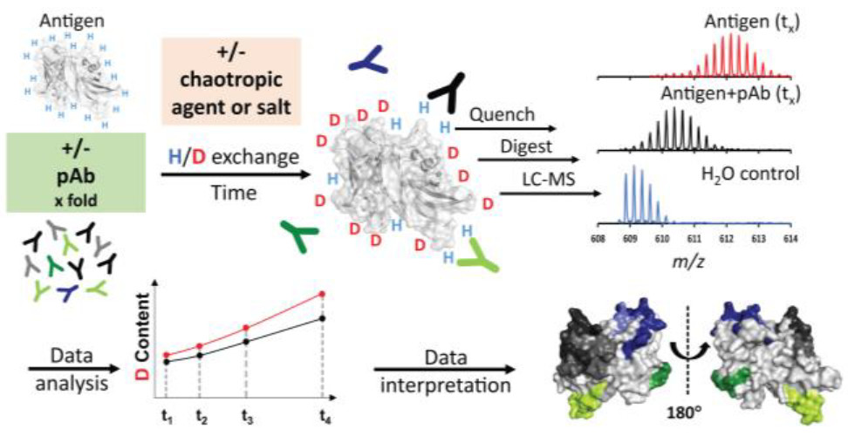
High-throughput shotgun mutagenesis epitope mapping
Shotgun mutagenesis is a high-throughput approach for mapping the epitopes of mAbs. The shotgun mutagenesis technique begins with the creation of a mutation library of the entire target antigen, with each clone containing a unique amino acid mutation (typically an alanine substitution) Hundreds of plasmid clones from the library are individually arrayed in 384-well microplates, expressed in human cells, and tested for antibody binding. Amino acids of the target required for antibody binding are identified by a loss of immunoreactivity. These residues are mapped onto structures of the target protein to visualize the epitope.
Hydrogen–deuterium exchange (HDX).
This method gives information about the solvent accessibility of various parts of the antigen and antibody, demonstrating reduced solvent accessibility in regions of protein-protein interactions. One of its advantages is that it determines the interaction site of the antigen-antibody complex in its native solution, and does not introduce any modifications (e.g. mutation) to either the antigen or the antibody.

Slide 14
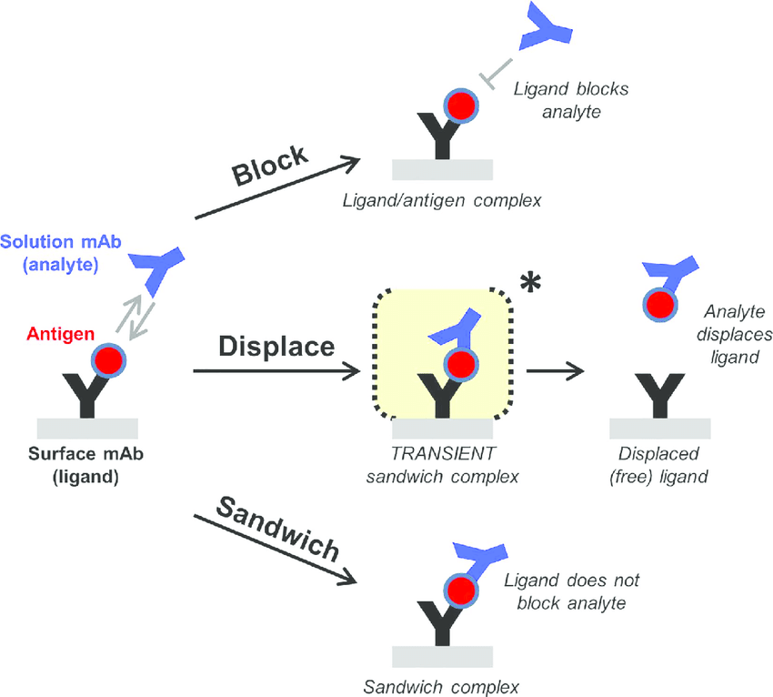
Epitope binning
Epitope binning is a technique used to cluster different monoclonal antibodies by the specific region on the antigen that is recognized by the antibody.
Epitope binning is generally referenced as epitope mapping or epitope characterization in the literature.
In epitope binning, you determine which of your different antibodies can bind to your antigens simultaneously, therefore recognise non-overlapping epitopes
Epitope binning immunoassays using surface plasmon resonance (SPR) can and should be deployed in the development of new potential drug candidates.

Slide 15
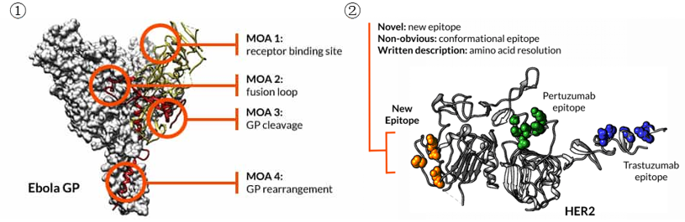
① Assay setup according to the specific program | ② Mutagenesis of the target protein | ③ Antibody screening with the designed mutation array | ④ Deliver final report including graphical representation of the epitope data, identification of critical residues, and mapped epitope.
State-of-the-art array-based SPR for high throughput epitope binning;
BLI platform-based Octet system;
Biacore system;
IBIS MX96&CFM platform;
ProteOn platform.
Epitope binning and mapping service will greatly support the mechanism of action understanding and the intellectual property claims of clients’ antibodies which can further facilitate your biologics drug discovery and development.”

Slide 16
B-Cell epitope prediction (in silico)
methods for continuous epitope prediction combine two or more residue properties with machine learning approaches
prediction methods can be divided based on the level of input information to methods based on antigen sequence and methods based on 3D structure of antigen. Structure-based methods significantly outperform sequence-based methods
existing prediction methods are not accurate enough and annotate general immunogenic/epitope-like regions on the antigen
consensus of various B-cell epitope prediction methods ensures greater accuracy of the results

Slide 17
Prediction of continuous B-Cell Epitopes
Tool | Source (URL) | Input data
ABCPred | http://www.imtech.res.in/raghava/abcpred/ | FASTA
APCPred | http://ccb.bmi.ac.cn/APCpred/ | FASTA
BCPREDS | http://ailab.ist.psu.edu/bcpred/ | FASTA
BepiPred | http://www.cbs.dtu.dk/services/BepiPred | FASTA or FASTA file
LBtope | http://crdd.osdd.net/raghava/lbtope/ | FASTA or FASTA file
Bcepred | http://www.imtech.res.in/raghava/bcepred/ | FASTA or FASTA file
SVMTriP | http://sysbio.unl.edu/SVMTriP/ | FASTA

Slide 18
Prediction of discontinuous B-Cell Epitopes
Tool | Source (URL) | Input data
DiscoTope | http://www.cbs.dtu.dk/services/DiscoTope-2.0/ | PDB ID or PDB file
BePro (PEPITO) | http://pepito.proteomics.ics.uci.edu/ | PDB ID or PDB file
ElliPro | http://tools.immuneepitope.org/ellipro/ | FASTA or Swiss-Prot ID
SEPPA | http://badd.tongji.edu.cn/seppa/ | PDB ID or PDB file
EPITOPIA | http://epitopia.tau.ac.il/ | FASTA/PDB ID or PDB file
CBTOPE | http://www.imtech.res.in/raghava/cbtope/ | FASTA or FASTA file
EPCES | http://sysbio.unl.edu/EPCES/ | PDB ID or PDB file
EPSVR | http://sysbio.unl.edu/EPSVR/ | PDB ID or PDB file
PEASE | http://www.ofranlab.org/PEASE | Ag PDB ID or PDB file Ab FASTA or FASTA file
EpiPred | http://opig.stats.ox.ac.uk/webapps/sabdab-sabpred/EpiPred.php | PDB ID or PDB file

Slide 19
B-cell epitope database
Database | Source (URL)
IEDB IEDB-3D | http://www.iedb.org/
AntiJen | http://www.ddg-pharmfac.net/antijen/AntiJen/antijenhomepage.htm
CED | http://immunet.cn/ced/
Epitome | http://www.rostlab.org/services/epitome/
BciPep | http://www.imtech.res.in/raghava/bcipep/info.html
SEDB | http://sedb.bicpu.edu.in
SDAP | https://fermi.utmb.edu/
HIV Molecular Immunology Database | http://www.hiv.lanl.gov/content/immunology/index.html
FLAVIdB | http://cvc.dfci.harvard.edu/flavi/

Slide 20
B-cell epitope features in antigens
Using MATLAB programming to classify the different features of a protein sequence to help predict a potential B cell epitope from a protein or a group of protein sequences. A protein sequence (FASTA format) with the accession number AAY57281.1 from the UniProtKB database was used as a test sequence in this study.
Beta-turn regions:Secondary structure elements in a protein are usually alpha helix, beta turn regions, and coil-coil regions. Beta turn region is relevant to epitope design.
Hydropathicity: This scale for amino acids was used to identify potential hydrophilic regions in the query protein for generating a plot with window size from i = 0 to i > N.
Surface accessibility: The empirical amino acid accessible surface probabilitieswhich are fractional probabilities (0.26 to 0.97) determined for an amino acid found on the surface of a protein is used. The most surface accessible area in a protein was determined with these fractional surface probabilities for amino acids, which a surface probability after calculating normalized surface accessible values for amino acids and a plot was generated
Antigenicity prediction: a semi-empirical method which utilizes physicochemical properties of amino acid residues and their probabilities or frequencies of occurrence in experimentally known segmental epitopes to predict antigenic determinants on proteins

Slide 21
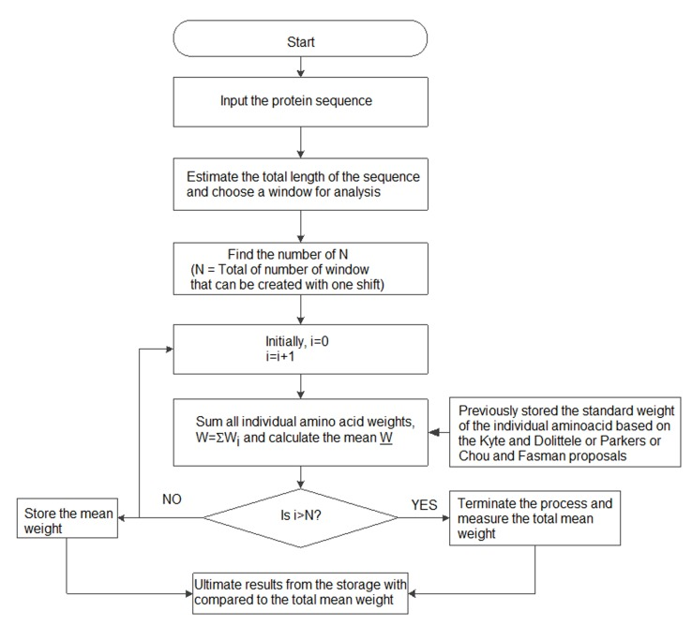
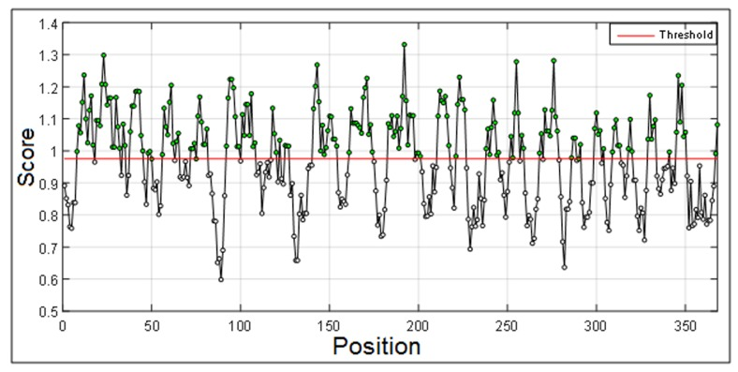
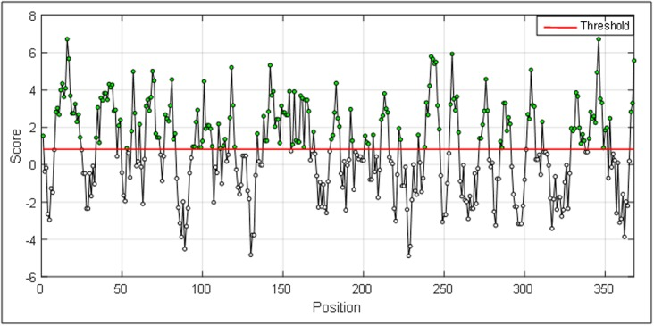
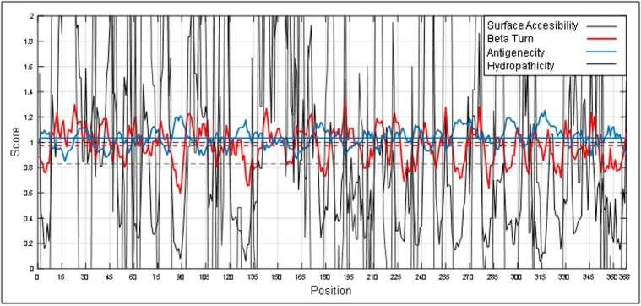
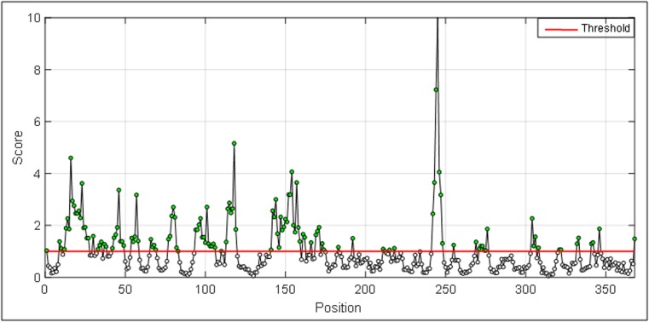
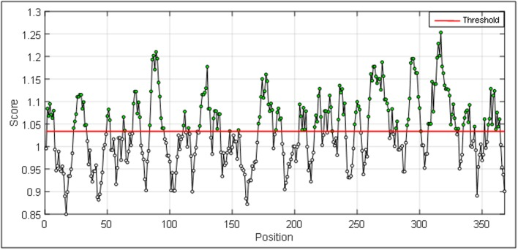
Graphical presentation of beta turn region in a protein antigen
Hydropathicity in a protein antigen.
A block diagram for grouping B cell epitope features in a protein antigen.
Combined view of beta turn, hydropathicity, surface accessibility and antigenicity in a protein antigen to define a potential B cell epitope.
Graphical presentation of surface accessibility in a protein antigen.
Graphical presentation of antigenicity in a protein antigen.
Notes:
the study concluded that, two 9-mer peptides could be the most effective B-cell epitopes of AAY57281.1. The results presented in this report matches known data for a potential B cell epitope (272-280) with more precision and sensitivity. This will reduce time and cost in finding a potential B cell epitope in a protein antigen.

Slide 22
Difference bwtn t cell & b cell Epitopes
Properties | Recognized by B cells and Antibodies | Recognized by T cells
Composition | Proteins, glycoproteins, polysaccharides, nucleic acids | Proteins
Configuration | Linear/conformational determinants | Linear determinants
Size | 4-8 residues | 8-15 residues
Number | Limited, located on the exposed surface of the antigen | Limited to those proteins that can be processed and bind to MHC

Slide 23
Epitope Spreading
Epitope spreading or ‘determinant spreading’ denotes ‘development of immune responses to endogenous epitopes secondary to the release of self-antigens during a viral infection or a chronic autoimmune or inflammatory response’.
In such conditions, sequestered autoantigens are exposed to autoreactive T cells causing autoimmune disease.

Slide 24
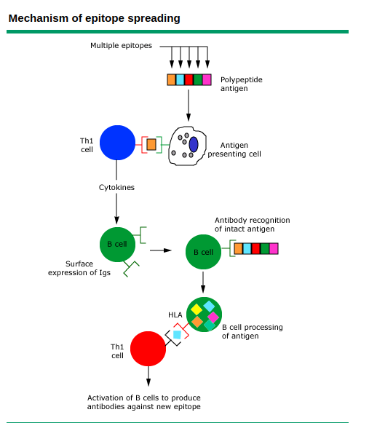
Mechanism of Epitope spreading
Multiple factors are involved in the induction of epitope spreading, such as:
enhanced display of previously hidden antigenic determinants under the local inflammatory/cytokine environment
Release of self-antigens following tissue damage
Role played by B cells as antigen-presenting cells.
Notes:
A polypeptide antigen (having multiple epitopes) is processed intracellularly by an antigen-presenting cell and a small peptide fragment is presented to a Th 1 cell.
The T cell responds to the peptide by releasing cytokines which stimulates a B cell to produce antibodies specific to the peptide fragment and also express antigen-specific immunoglobulins on the cell surface.
Surface immunoglobulin of B cells subsequently recognize the intact antigen, internalize it, and process it. But, in this case, B cell presents a new peptide epitope via MHC class II to a T cell, thereby initiating the production of different antibodies to a new epitope of the same antigen.
This broadening of the immune response can target epitopes either within the same antigen (intramolecular spreading) or another antigen (intermolecular spreading).
Multiple factors are involved in the induction of epitope spreading, such as:
enhanced display of previously hidden antigenic determinants under the local inflammatory/cytokine environment
Release of self-antigens following tissue damage
Role played by B cells as antigen-presenting cells.

Slide 25
Affinity maturation
Targeting effectual epitopes is essential for therapeutic antibodies to accomplish their desired biological functions.
As modulators of molecular interactions with high affinity and high specificity, monoclonal antibodies have emerged as important therapeutics targeting cancers, immune diseases and infections
Affinity and specificity, along with the therapeutic efficacy of a given monoclonal antibody often depends on the specific epitope recognized. i.e. exactly where on the antigen binding occurs
Generation of potent antibodies by a mutation-selection process called affinity maturation is a key component of effective immune responses
Affinity maturation is an important strategy in antibody optimization to generate safe and efficacious second-generation therapeutics
Affinity maturation is the process by which B cells increase their affinity for a particular antigen

Slide 26
How does affinity maturation occur
Affinity maturation primarily occurs on membrane immunoglobulin of germinal center (GC) B cells and as a direct result of somatic hypermutation (SHM) and selection by TFH cells.
Affinity maturation occurs within the GC, where somatically mutated BCRs undergo selection on antigen retained on follicular dendritic cells
Antigen is retained in the form of Immune Complexes (ICs) and involves the interaction of both complement receptors and FcγRIIB with these ICs on FDCs. B cells also express both complement and FcγRIIB.
Notes:
Follicular dendritic cells (FDCs) are stromal cells residing in primary follicles and in germinal centers of secondary and tertiary lymphoid organs
There, they play a crucial role in B-cell activation and affinity maturation of antibodies
The FDC function is to bind and retain antigens by linking to complement and immune complexes and then present these antigens to germinal center B cells that start the secondary immune response.

Slide 27
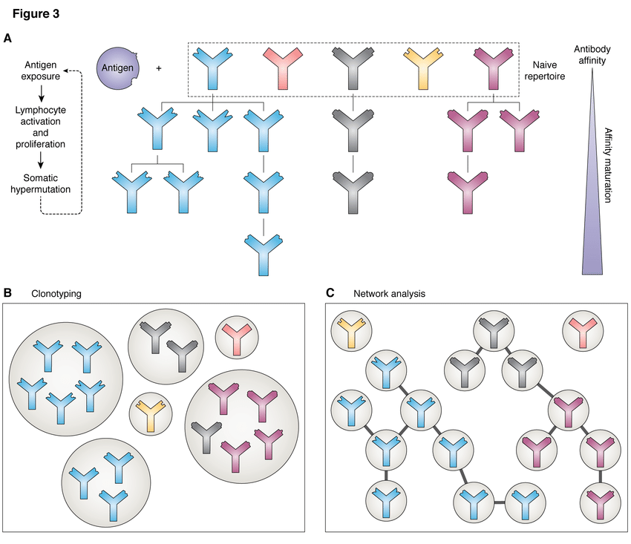
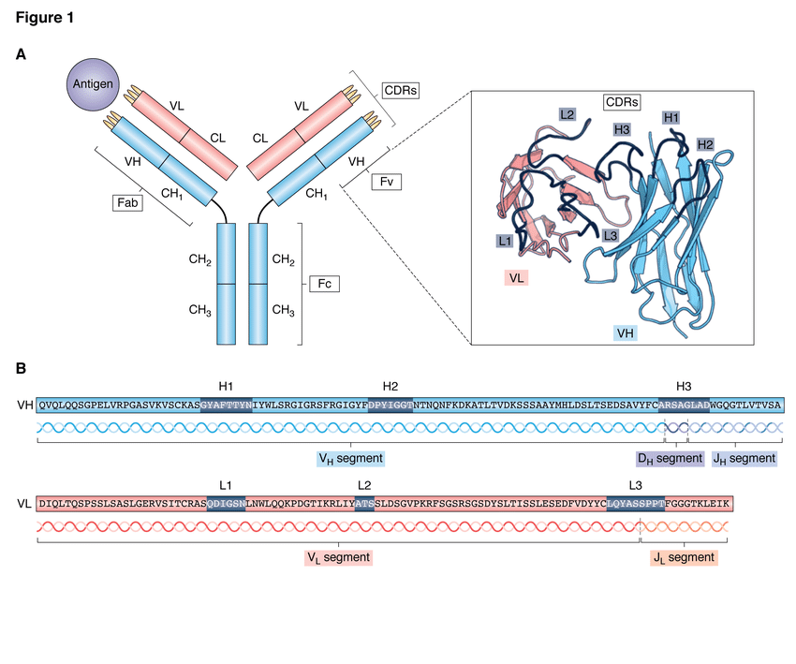
The process of affinity maturation and methods of analysing the resulting antibody repertoires.
A -Upon exposure to an antigen, those antibodies present in the naive repertoire that are able to bind to it proliferate, undergoing somatic hypermutation to produce variations upon the initial binder. Successive rounds of this process produce antibodies with high affinity.
B -Clonotyping groups antibodies in the repertoire based on sequence similarity; normally they must originate from the same V and J genes and have an H3 sequence identity of 80-100%. Antibodies of the same clonotype are predicted to bind to the same epitope.
C -Network analysis of antibody repertoires, where each node is a different sequence and edges are present between them if they meet set sequence similarity criteria. The lineages of different antibodies can be inferred using this method.

Slide 28
Neutralizing antibody (Nab)
A neutralizing antibody (NAb) is an antibody that defends a cell from a pathogen or infectious particle by neutralizing any effect it has biologically.
Neutralization renders the particle no longer infectious or pathogenic
Neutralizing antibodies are part of the humoral response of the adaptive immune system against viruses, intracellular bacteria and microbial toxin.
By binding specifically to surface structures (antigen) on an infectious particle, neutralizing antibodies prevent the particle from interacting with its host cells it might infect and destroy.

Slide 29
Mechanism
Neutralizing antibodies can inhibit the infectivity by binding to the pathogen and block the molecules needed for cell entry.
This can be due to the antibodies statically interfering with the pathogens or toxins attaching to host cell receptors.
In case of a virus infection, NAbs can bind to glycoproteins of enveloped viruses or capsid proteins of non-enveloped viruses.
Can act by preventing particles from undergoing structural changes often needed for successful cell entry
Neutralizing antibodies are also important in neutralizing the toxic effects of bacterial toxins.
Notes:
In order to enter cells, pathogens such as circulating virus particles or extracellular bacteria use molecules on their surfaces to interact with the cell surface receptors of their target cell which allows them to enter the cell and start their replication cycle.

Slide 30
Nab in virus infection
NAbs could be defined as antibodies that bind to the free virus and prevent it from infecting cells
Antibody neutralization is defined as the “abrogation of virus infectivity in vitro by the binding of antibodies to the virion” and that binding may affect the virus at one or more stages in the viral infection cycle.
The role of antibodies in host protection against viral infections has been amply demonstrated.
Antibodies neutralize viral infection or replication by targeting viral glycoproteins of enveloped viruses (such as the SARS-CoV-2 Spike (S) protein) or the protein shell of nonenveloped viruses.
These proteins bind to cellular receptors and cellular membranes and mediate the viral fusion and penetration into the cytosol, respectively

Slide 31
Mechanisms
Neutralization can be achieved through four main mechanisms
NAbs binding to viral surface proteins and blocking their interaction with the host cell receptor and infection
NAbs binding to viral protein epitopes that interact with host cell coreceptors that are key for viral infection
NAbs binding to viral epitopes that are not essential for host cell receptor binding but are necessary for conformational changes needed for membrane fusion
A variant of this mechanism would be the capability of NAbs to bind to proteins essential for host cell receptor binding, but NAbs are bound to distal epitopes of fusogenic proteins (internalized), preventing complete fusion

Slide 32
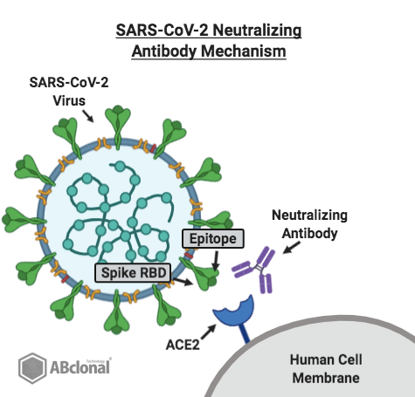
NAbs generally block the binding of the virus to cellular receptors; however, in some cases, they may prevent conformational changes necessary for fusion of the virus with the cell membrane or proteolytic cleavage
For enveloped viruses, the latest step blocked seems to be membrane fusion, i.e., entry into the cytoplasm.
the function of NAbs is mediated by a region called fragment antigen-binding (Fab), and non-neutralizing antibodies exert their effect near the crystallizable region (Fc)
The neutralizing action is carried out through the variable fraction (Fab) of the antibody, whose primary limitation is viral resistance. Here, effector mechanisms enter to avoid viral replication

Slide 33
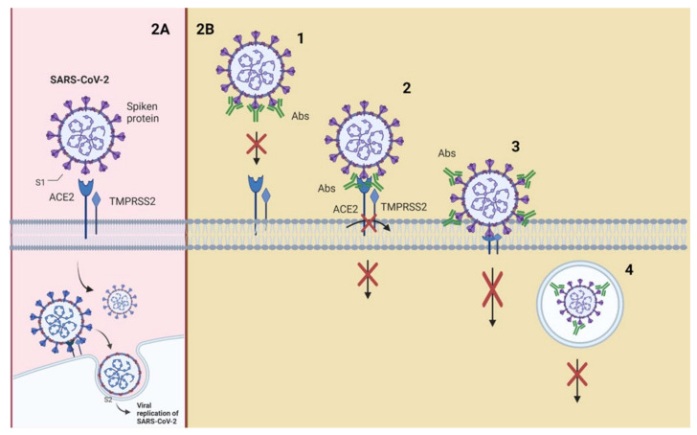
SARS-CoV-2 attaches to the host cell with the aid of the spike (S) glycoprotein present on its envelope
S glycoprotein is composed of two subunits (S1 and S2) that have to be cleaved to allow for viral fusion with the cell membrane, entry into the cell, and initiation of the replication process
Transmembrane serine protease 2 (TMPRSS2) or endosomal cysteine proteases cathepsins B (CTSL) and L (CTSB) perform this excision
Protease cleavage at the S2′ site frees the fusion peptide from the new S2 N-terminal region
This fusion peptide is inserted into the host membrane and facilitates the pulling of the viral and host cell membrane into close proximity, leading to membrane fusion
Angiotensin-converting enzyme 2 (ACE2), an enzyme located on the outer surface of a wide variety of cells, is the primary host cell target of the receptor-binding domain (RBD) of the S1 subunit
This suggests that disruption of the RBD–ACE2 interaction would block SARS-CoV-2 cell entry; therefore, RBD has been suggested as the main target of NAbs against SARS-CoV-2

Slide 34
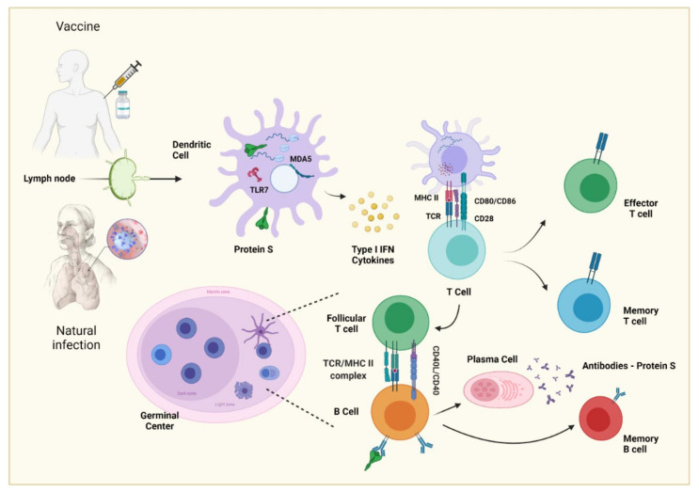
Generation and Characteristics of a Neutralizing Antibody
Affinity maturation is based on the somatic mutation of the germline genes of immunoglobulin, a process called somatic hypermutation (SHM)
specialized microstructures formed in secondary lymphoid tissues upon infection or immunization, producing long-lived plasma cells and memory B cells, which protect against reinfection
GCs are organized into two regions, the dark zone (DZ) and the light zone (LZ)

Slide 35
In the DZ, there are B cells with a high proliferation rate (called centroblasts) and SHM
The centroblasts then enter the LZ (now are called centrocytes), where they capture and process antigens present on follicular dendritic cells (FDC)
they subsequently present antigenic peptides to T follicular helper (Tfh) cells to in order receive critical survival signals and undergo selection
FDCs can have the ability to retain the native antigen to carry out the previous process, in addition to producing cytokines, such as BAFF, that help in the survival of the B cell
Z class-switch recombination (CSR) also occurs, where the constant region of the heavy chain of the antibody is changed, allowing B cells to produce IgG antibodies, IgA or IgE.
This process diversifies the effector functions of antibodies, e.g., IgG can activate NK cells and phagocytes to eliminate cells infected by pathogens
final stage of the germinal center process, the centrocytes exit the GC as memory B cells or high-affinity antibody-secreting plasma cells
In the case of a plasma cell, the key is the activation of the Blimp1 master regulator (Prdm1), which, among many other functions, helps to stop the expression of transcription factors

Slide 36
For memory B cells, there is no established master regulator
Plasma cells reside in the bone marrow and constitutively secrete antibodies do not possess antibodies
memory B cells express BCR but do not secrete antibodies constitutively. When they meet again with the antigen, they can reactivate and form GCs to produce antibodies with a greater affinity; moreover, these cells can give rise to plasma cells and reside in circulation or peripheral lymphoid tissue
NAbs can come from both populations of B cells, but it is most probably that bNAbs come from evolved memory B cells recruited into the plasma cell compartment.
NAbs could have increased affinity for antigen compared to the corresponding naive B-cell receptors but a higher affinity does not always define a higher neutralizing capacity.

Slide 37
The required levels of SHM and affinity maturation may vary from target to target; for example, while chronic infection may result in mutation levels from their germinal genes upwards of 30%, as seen in HIV-1 broadly neutralizing antibodies (bNAbs),
mutations of 5–20% may provide sufficient maturation for effective neutralization, which could be more readily achieved by vaccination
mutation levels over 20% may be difficult to achieve by vaccination; thus, they consider goal mutation levels closer to 5–15% for those NAbs targeting specific and multiple sites of vulnerability
The complementarity determining regions (CDRs) with more mutations are also variables for each type of antibody depending on the virus; as an example, for HIV-1, it has been seen to have a greater effect on CDR H3
Regarding SARS-CoV-2, Graham et al. reported a low percentage of SHM in VH and VL genes (mean of 1.9% and 1.4%, respectively) following an acute infection

Slide 38
references
Sanchez-Trincado, J. L., Gomez-Perosanz, M., & Reche, P. A. (2017). Fundamentals and Methods for T- and B-Cell Epitope Prediction. Journal of Immunology Research, 2017, 2680160. https://doi.org/10.1155/2017/2680160
Powell, A. M., & Black, M. M. (2001). Epitope spreading: Protection from pathogens, but propagation of autoimmunity? Clinical and Experimental Dermatology, 26(5), 427–433. https://doi.org/10.1046/j.1365-2230.2001.00852.x.
An Introduction to Antibodies: Antigens, Epitopes and Antibodies. (n.d.). Sigma-Aldrich. Retrieved May 31, 2021, from https://www.sigmaaldrich.com/technical-documents/articles/biology/antigens-epitopes-antibodies.html
Epitope spreading. (n.d.). Retrieved June 1, 2021, from https://somepomed.org/articulos/contents/mobipreview.htm?29/48/30471
Cruse, J. M., Lewis, R. E., & Wang, H. (Eds.). (2004). 2—ANTIGENS, IMMUNOGENS, VACCINES, AND IMMUNIZATION. In Immunology Guidebook (pp. 17–45). Academic Press. https://doi.org/10.1016/B978-012198382-6/50026-1
Kuby Immunology, 8th Edition

